Slide 1

Prepared by group 2
TravelAware
Introducing our AI app
6 August, 2025

Slide 2




Team Members
Krishna Reddy Bovilla
Adhitya Kondeti
Tracy (Yu-Chen) Chou
Erica Holden
Developer
Developer
Product Owner
Scrum Master

Slide 3
Introduction:
TravelAware is a safety-focused application designed to help users make informed decisions about their surroundings by providing real-time or recent crime data based on their location. With a growing need for personal safety, especially in unfamiliar areas. TravelAware aims to act as a proactive guide, alerting users to potential crime hotspots and helping them plan safer routes. By analyzing public crime datasets and integrating them with location services, our tool empowers users to stay alert, aware, and secure anywhere they go.

Slide 4

Project Overview – TravelAware
TravelAware: Crime Level Detection & Hotspot Prototype
Key Points:
Focused on enhancing public safety for tourists and international students.
Built as a rapid prototype to demonstrate real-time safety insights.
Main Objectives:
Display crime hotspots and clusters on an interactive map.
Machine learning models to predict crime urgency and estimated response time from user reports
Integrate predictions into a Streamlit app with:
SOS simulation
Smart warnings for dangerous zones
Safe route suggestions

Slide 5

Why Agile?
Why We Chose Agile for TravelAware
Key Reasons:
Flexibility to adapt quickly during development.
Supports short feedback loops, crucial for prototyping.
Avoids the rigidity of Waterfall, where feedback comes too late.
Allows for continuous delivery and iteration across sprints.
Agile Principles Followed:
Individuals and interactions over processes and tools – We prioritized collaboration.
Working software over comprehensive documentation – Our focus was getting a functional prototype ready fast.
Customer collaboration, we aligned closely with Tracy, our Product Owner, to shape backlog priorities.
Responding to change, quick feature pivots were made based on feasibility and user value.

Slide 6
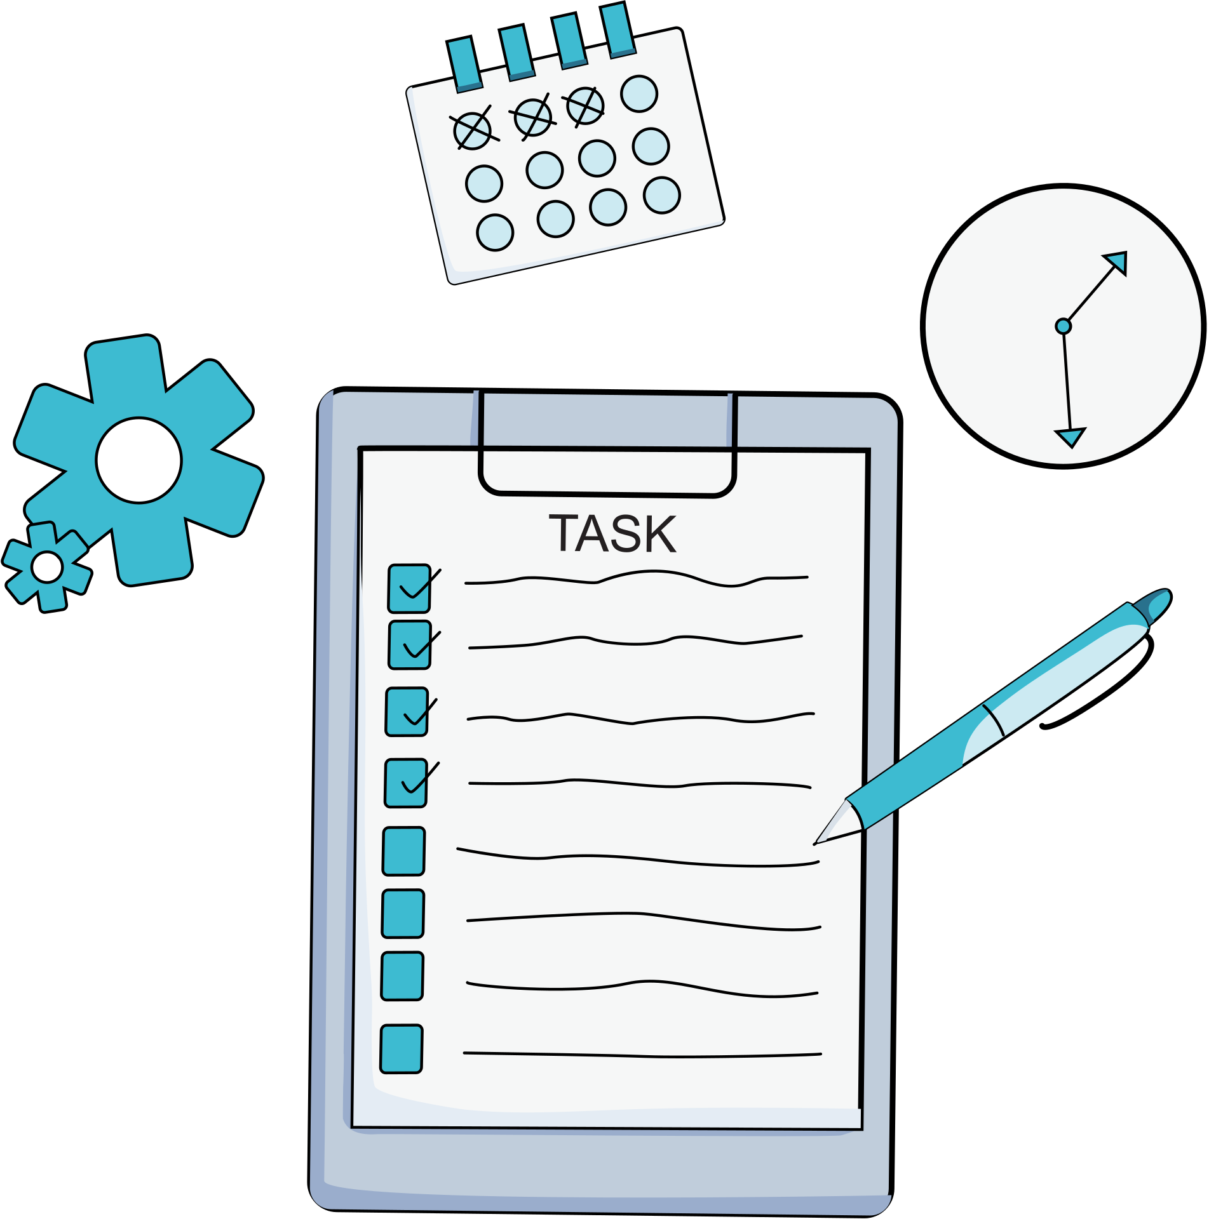
Scrum Framework in Action (Roles, Artifacts & Tools)
Scrum Roles
Product Owner – Tracy ➤ Defined product vision and prioritized user stories.
Scrum Master – Erica ➤ Facilitated Scrum ceremonies, removed blockers, ensured team alignment.
Developers – Krishna & Adhitya ➤ Implemented ML model, map integration, and app features like alerts & predictions.
Tools & Practices
Trello: Task management with Backend/Frontend/Testing swimlanes
Microsoft Teams: 10 AM daily stand-ups
Scikit-learn: ML model pipeline
Streamlit: Interactive app frontend
Scrum Artifacts
Product Backlog ➤ Crime prediction model, SOS feature, safe route planning, map UI.
Sprint 1 Backlog Highlights
Real-time crime alerts
Interactive map for high-crime zones

Slide 7

Tracking Progress & Sprint Outcome:
Progress Tracking
No formal burndown charts used,
Tracked progress through:
Trello task updates
Daily check-ins for task alignment and blockers
Sprint Planning Outcome
Sprint Goal: Deliver TravelAware’s first working safety system
Tasks were divided based on team capacity and expertise
Successfully delivered a functional prototype including:
86% prediction accuracy (Random Forest model)
Interactive map interface for crime hotspots
Safety features: Alerts, SOS simulation, and route suggestions

Slide 8





Personas
Jessica
Rohan
Mark
Kittu
Sarah

Slide 9

Epics & User Stories
1 View crime information
2 Keep a profile with history
3 Send notification alert
4 Create real-time alerts

Slide 10

Rapid Prototype
Objective
Show the crime hotspot and clusters
Predict crime severity as Low, Medium, or High
Use simplified features like crime type, time, crime level,
Integrate model predictions into an interactive crime map
Demonstrate feasibility for a real-time safety assistant
Week 1
Sampled 1,000 rows from WRPS 2023 dataset
Extracted features and cleaned missing values
Trained a Random Forest Classifier using Scikit-learn pipeline
Saved model as .pkl for app integration
Integrated model into Streamlit app
Enabled map-based predictions with marker click detection

Slide 11
Rapid Prototype
Outcome
Show the hotspots and clusters for crime
Predict the crime level
86 % Accuracy achieved high f1 score, precision and recall
Interactive app demonstrates potential for real-time public safety support

Slide 12
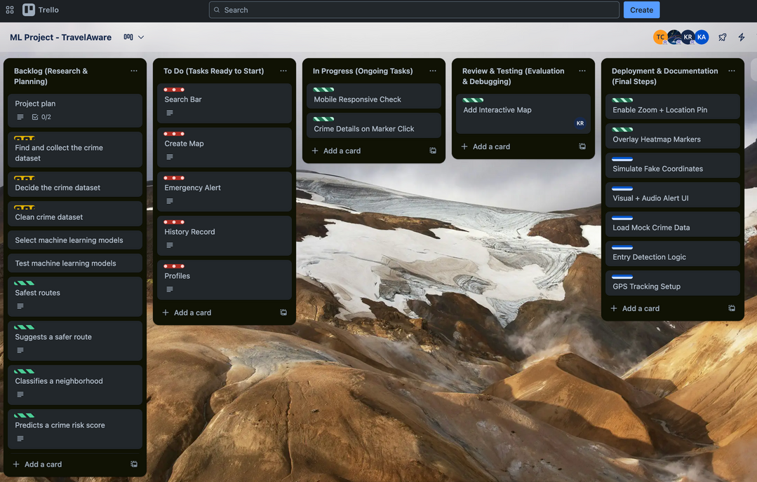
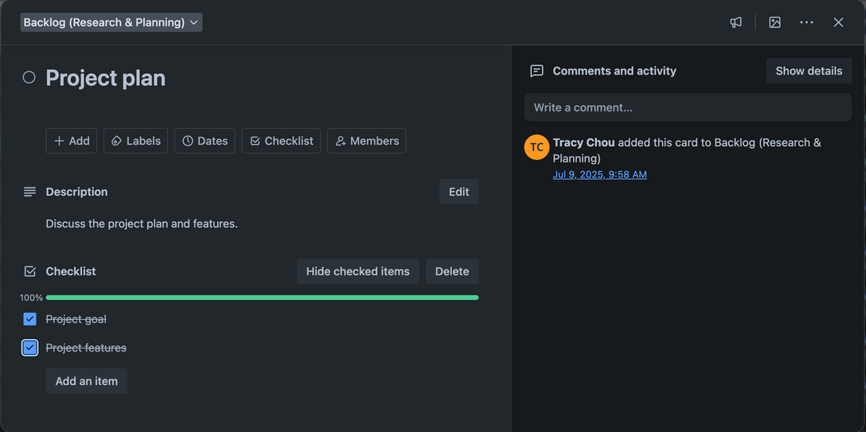
Collaboration and Feedback - Building an Agile Cycle at TravelAware
Key point:
We ensure TravelAware remains user-centric through intensive collaboration and real-time feedback.
Feedback-Based Iteration:
Sprint Planning: The team jointly sets goals for TravelAware's core safety system, breaks down tasks, and assigns them to developers.
Daily Stand-ups: Daily progress is synchronized, development obstacles are quickly resolved, and the team remains aligned.
Trello Agile Board: Visualize work progress, improve transparency, and achieve seamless collaboration.

Slide 13

Collaboration and Feedback - Building an Agile Cycle at TravelAware
Key point:
We ensure TravelAware remains user-centric through intensive collaboration and real-time feedback.
Usability Testing and Feedback:
Sprint Review: Demonstrate TravelAware's MVP features (maps, alerts, etc.) to stakeholders to gather their direct feedback.
Target Audience Feedback: Focus on obtaining valuable feedback from target users, such as tourists and international students, to validate the design of TravelAware.
Result: Quickly identify usability issues and ensure the product design aligns with user needs.
TravelAware

Slide 14
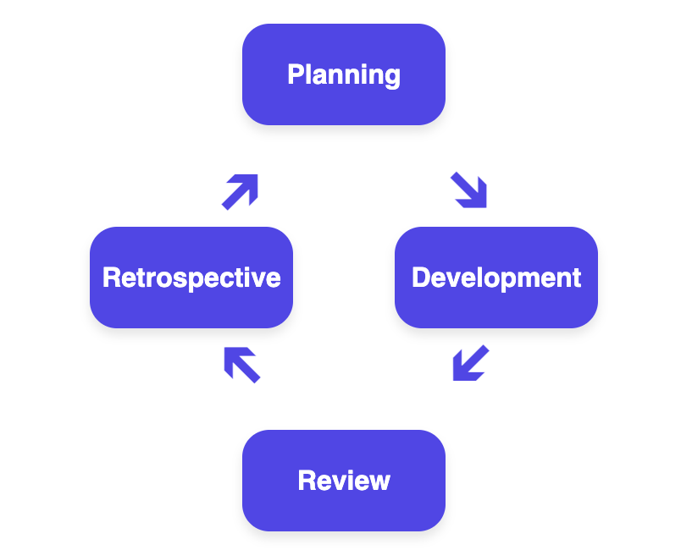
Iteration Cased on Feedback - Let TravelAware Continue to Evolve
Key point: TravelAware continually enhances its value through ongoing iteration, transforming feedback into tangible improvements.
Agile Iteration Cycle:
Each Sprint is a Learning Opportunity: Our development process uses short, efficient iterations, allowing us to respond quickly to changes.
From MVP to Optimization: TravelAware roadmap shows how we iterated from a basic "display crime hotspots" feature to "more readable maps" and "crime level filtering."
Feedback Translated into Action:
Updated Product Backlog: Feedback from the Sprint Review is directly translated into new or revised PBIs, ensuring the next Sprint focuses on the most valuable tasks.
Culture of Continuous Improvement: The Sprint Retrospective allows us to reflect on and optimize team collaboration and processes, improving not only TravelAware but also team efficiency.

Slide 15
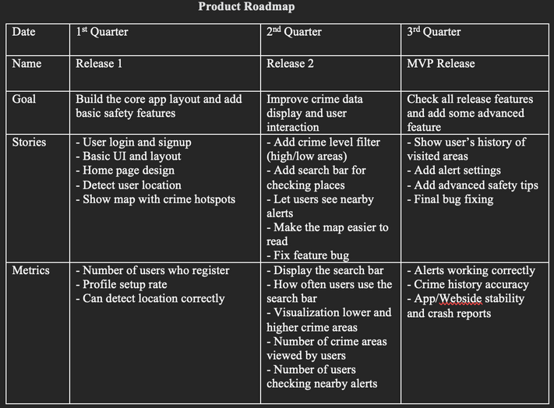
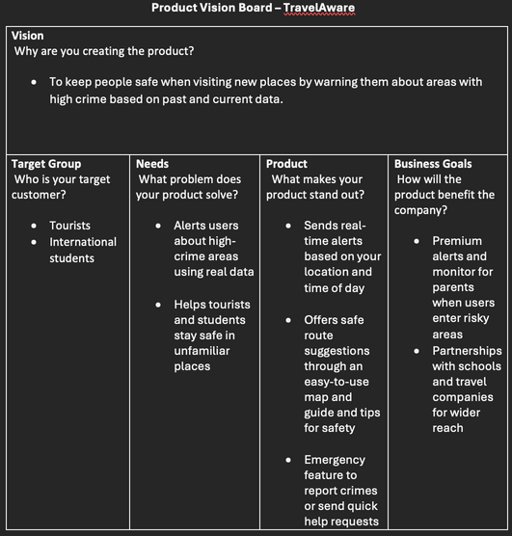
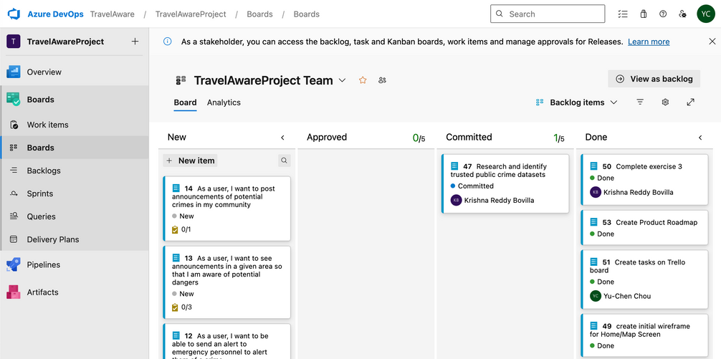
Agile Product Management - Tools for Collaboration and Transparency
Key point:
Use agile tools to ensure collaboration, consistency, and transparency of team and project goals.
Agile Tools and Collaboration:
Product Vision Board: Establishes TravelAware's core vision, clearly defines its target customer and solution, and serves as the foundation for all development decisions.
Product Roadmap: Plans TravelAware's development roadmap, breaking down the vision into actionable milestones and defining user stories for each phase.
Agile Board: Use Trello and Azure DevOps to visualize workflows, clearly displaying the status of each task, assigning tasks to teams, and tracking progress.

Slide 16
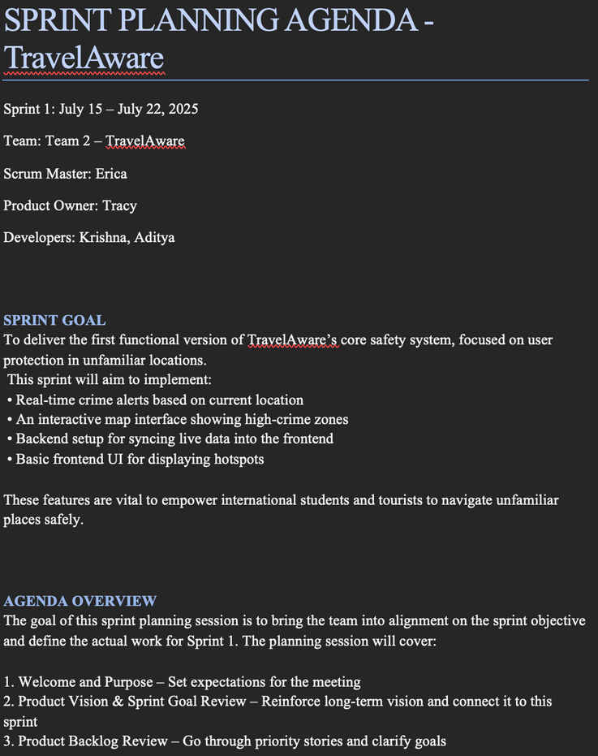
Agile Product Management - Tools for Collaboration and Transparency
Key point:
Use agile tools to ensure collaboration, consistency, and transparency of team and project goals.
Goals and Metrics:
Sprint Goal: Each sprint has a clear goal for TravelAware's core functionality.
Measurable Metrics: Product feature success is measured through metrics such as "number of registered users" and "number of location views."

Slide 17


Stakeholder Management - Communication and Response Strategies
Key point:
Ensure high alignment between stakeholders and TravelAware development through structured communication and flexible response.
Stakeholder Management Strategy:
Regular Communication: Sprint Reviews showcase TravelAware's completed work to stakeholders and gather direct feedback.
Team Role Definition: Ensure clear responsibilities and accountability for each role.
Coordination and Alignment: Through Program Increment Planning, we ensure that the goals of multiple teams (Agile Release Trains) are aligned with the business vision to avoid silos.
---------->
Stakeholder
Scrum Team

Slide 18
Stakeholder Management - Communication and Response Strategies
Key point:
Ensure high alignment between stakeholders and TravelAware development through structured communication and flexible response.
Sprint Review
(feedback)
PBI
(next Sprint)
Communication and Pivots:
Continuous Feedback Loop: Stakeholder feedback from Sprint Reviews is used to update PBIs to ensure product direction is aligned with requirements.
Adaptive Capability: Agile development allows us to flexibly adjust priorities and TravelAware's direction based on new feedback or business needs after each Sprint, without having to wait until the project is complete.
Learning from Challenges: Sprint Retrospectives allow us to identify process bottlenecks and propose optimization solutions, enhancing the team's ability to continuously improve.
------->
------->
Optimization scheme
Sprint Retrospective
------->

Slide 19
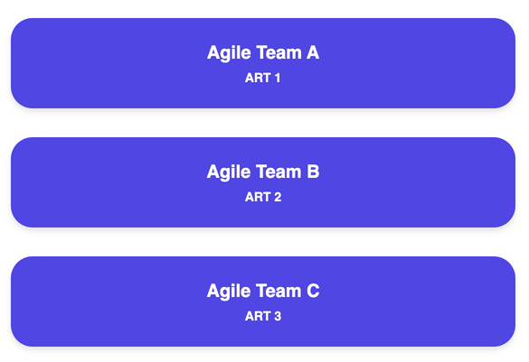

Agile at Scale - Collaboration Across Teams and Modules
Key point:
To meet the challenges of large-scale projects, we adopted SAFe (Scaled Agile Framework) to improve cross-team collaboration and overall project consistency.
Scaling Agile Practices:
Agile Release Trains (ARTs): Leverage cross-functional teams to collaborate and deliver consistent Program Increments (PIs). Ensure development work across teams is synchronized and coordinated.
PI Planning Sessions: Regular meetings are held to ensure that all ARTs' work is aligned with business objectives. That reduces delays caused by dependencies and improves project transparency and coordination.
Agile Portfolio Management: Dedicated teams are established to closely align development work with the company's high-level business goals, ensuring that TravelAware's development direction is aligned with the company's strategy.
Program Increment Goal
PI Planning Sessions
Aligning on a common vision and goals

Slide 20


Agile at Scale - Collaboration Across Teams and Modules
Key point:
To meet the challenges of large-scale projects, we adopted SAFe (Scaled Agile Framework) to improve cross-team collaboration and overall project consistency.
Results:
Faster time to market: Accelerate TravelAware releases through coordinated development.
Higher collaboration: Break down team silos and facilitate cross-team communication.
Improve project alignment: Ensure all teams are aligned towards a common vision and goals.
TravelAware

Slide 21

Quality Management & Testing
Testing Approach
Quality was embedded throughout the development process using Agile testing principles:
Incremental Testing:
Testing was performed during each sprint to validate new functionality, rather than waiting until the end.
Layered Testing Strategy:
Unit Testing: Applied to key logic components such as ML model input/output and route validation.
Integration Testing: Ensured communication between the map interface, reporting form, and predictive models.
Usability Testing: Conducted peer-based walkthroughs to validate the user experience, navigation flow, and feature clarity.

Slide 22
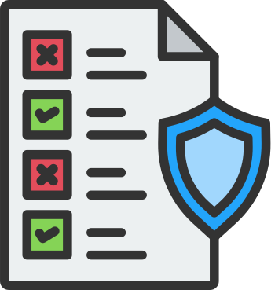
Quality Assurance Practices
We applied lightweight, Agile-friendly QA techniques suitable for a rapid prototyping cycle:
Peer Review & Pair Collaboration:
Code, UI flow, and design decisions were reviewed collaboratively to catch issues early and maintain consistency.
Version Control Discipline:
Git was used to manage feature branches, isolate development, and reduce merge conflicts.
Continuous Feedback Loop:
Feedback from sprint reviews and usability tests informed immediate adjustments in subsequent iterations.
Manual Regression Checks:
Core features like reporting, routing, and alerts were retested manually after each change to ensure stability.

Slide 23
ITERATIVE QUALITY CYCLES
Each sprint followed a continuous quality loop aligned with Agile best practices. The team adopted a Build → Test → Refine cycle to embed quality into every stage of development without relying on heavyweight QA infrastructure.
Step 1: Build
Step 2: Test
Step 3: Refine
Sprint Planning
Tasks were estimated with quality considerations in mind, ensuring that testing and feedback were scoped into each sprint goal.
Sprint Review
Functional and usability feedback was gathered from peers and stakeholders, validating feature behavior and user experience.
Sprint Retrospective
Any missed bugs or quality issues were captured and addressed in the next sprint, promoting continuous improvement.

Slide 24
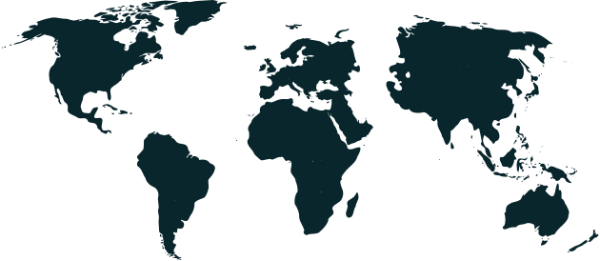
Real-World Application Relevance
Target User Group
Tourists
Often unaware of crime-prone areas; need real-time alerts and visual indicators to make informed travel decisions.
International Students
New to the city and public transit systems; require localized safety guidance and commuting support.
Shift Workers
Often commute late at night and require situational safety awareness.
Public Transit Users
Move through unfamiliar or changing locations; need zone-based safety updates and incident awareness
Ride-Share Drivers
Seek route-level safety information and recent crime alerts.

Slide 25


Delivered Outcomes
Real Time Map
Safe Route Suggestions
SOS & Smart Alerts
Displays real-time crime data using heatmaps, clusters, and clickable hotspots for spatial awareness.
Notifies users when entering high-risk areas and simulates emergency contact logic.
Auto Zone Detection
Generates alternate travel paths based on nearby crime zones and recent incident patterns.
Automatically centers the map based on user location and highlights nearby risk zones.

Slide 26

Project Metrics Summary
Model Accuracy – 86% (F1 Score) | ETA Prediction Error RMSE ≈ 4.2 minutes
Map Load Time < 2.5 seconds average | User Rating 8.6 / 10 on usability tests
Crime Dataset 40+ incidents across 5 zones | Smart Alerts Triggered if >7 crimes / 1km
Route Safety Engine 80% route accuracy vs. crime zones | App Stability Zero crashes in final sprints
THESE METRICS REFLECT SYSTEM PERFORMANCE, USER FEEDBACK, AND MODEL RESULTS CAPTURED THROUGHOUT DEVELOPMENT AND SPRINT TESTING.

Slide 27

Heatmap & Cluster View Toggle Switch between heatmap and clustered markers for clear visualization of crime distribution.
Polygon-Based Zone Detection Outlines high-crime areas using color-coded polygons linked to cluster zones.
Crime Reporting with Smart Feedback Enables users to submit incidents and receive urgency and ETA predictions via trained ML models.
Safe Route Suggestions Recommends safer travel paths by avoiding nearby crime zones using dynamic geospatial logic.
Smart Alerts & Crime Feed Displays top-banner alerts during crime spikes and shows a live, scrollable feed of recent incident
Auto-Geolocation with Fallback Detects current location or defaults to Waterloo to ensure reliable map centering and alerts.
Completed Items
THESE CORE FEATURES WERE SUCCESSFULLY IMPLEMENTED DURING OUR AGILE SPRINTS.
EACH ITEM WAS TESTED FOR FUNCTIONALITY, USABILITY, AND REAL-WORLD VALUE.
THIS MARKS THE MVP COMPLETION OF THE TRAVELAWARE PROTOTYPE.

Slide 28


Planned Enhancements:
Strategic improvements aimed at increasing usability, accuracy, and public impact in future development phases.
Live Data Integration
Mobile Optimization
Multilingual Support
Connect to real-world crime APIs (e.g., Open Data Waterloo) for continuously updated crime reports and analysis
Integrate & Enhance responsiveness and performance across mobile devices to support broader public usage and field testing.
Implement language options to support international users, tourists, and newcomers in urban areas.

Slide 29
Live Demo

Slide 30





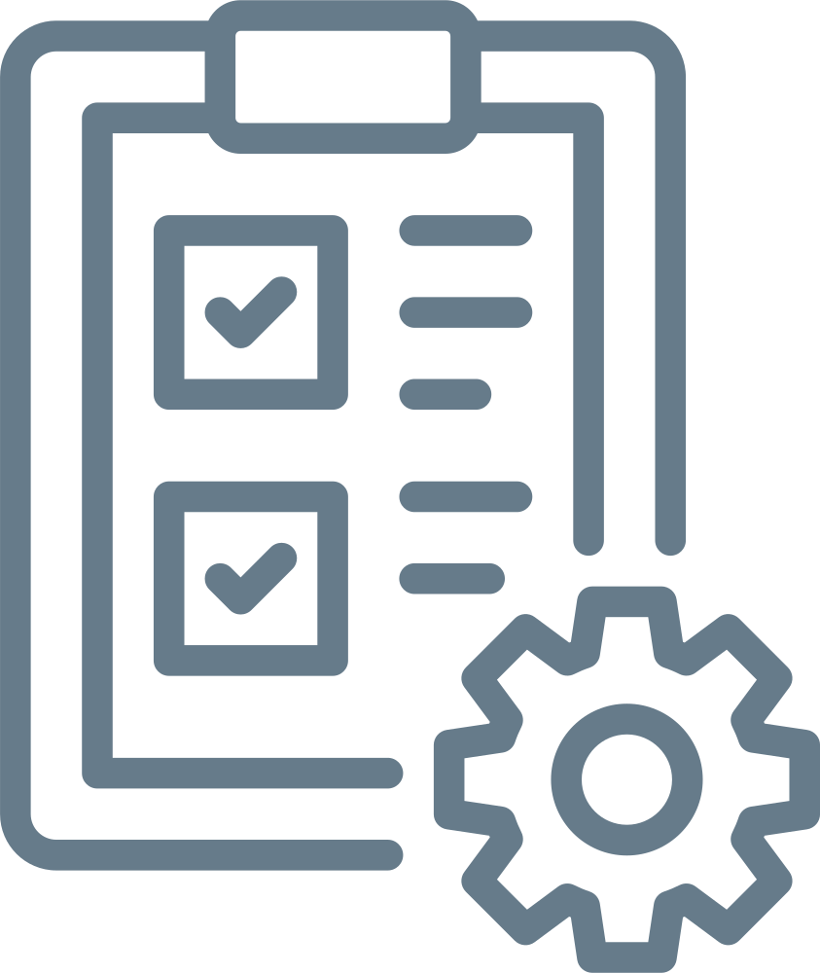
KEY SPRINT IMPROVEMENTS
Key feature enhancements implemented through iterative sprint cycles.
sprint 2
sprint 3
sprint 4
sprint 5
sprint 6
STEP 7
Crime Clustering
ML Model Integration
Safe Route Suggestion
UI Enhancements
Live Crime Feed
Smart Alerts
Implemented zoom-level based crime clustering
to enhance readability and focus on local risk zones.
ntegrated urgency classification and ETA prediction
to provide intelligent feedback during crime reporting.
Developed route advisor to suggest safer paths
based on nearby crime concentration.
Introduced top-banner alerts when recent crime
density exceeds a safe threshold near the user.
Reorganized crime report form placement and added
polygon overlays with gradient fill for crime zones.
Built a live, scrollable crime feed with timestamps
to keep users informed of nearby incidents.

Slide 31

Any Questions ?

Slide 32

Feedback ?

Slide 33

Thank you

